Slide 1
Day 14

Slide 2
SLURM

Slide 3
Agenda
Workload Managers
Introduction to Slurm
Modes of program execution
SLURM Commands
Sample SLURM Job Script
SLURM Job Monitoring Commands

Slide 4
Workload Managers
System to allocate shared compute resources to users of a large compute system
There is more compute work to be done than compute resources available at any given moment
Workload is managed by a resource manager and a job scheduler
Resource manager:
- Monitors node availability and load (usage)
- Manages CPU, network, disk, memory, etc. in a cluster
Job scheduler:
- Sends compute tasks to nodes
- Manages queues and priority
- Key Functions: Job submission ,Queuing and Job Priorities

Slide 5

Factors determining job execution
Some factors for determining which jobs get run:
- Current system load
- Submitting user’s fair-share usage
- Submitted job’s requested resources
Resource Allocation
Job Prioritization
Efficient scheduling strategies

Slide 6
Types of Workload Managers
Several solutions to this problem:
Portable Batch System (PBS)
Simpler Linux Utility for Resource Management (SLURM)
Moab
Univa Grid Engine
LoadLeveler, Condor
OpenLava
IBM’s Platform LSF
…

Slide 7

Introduction SLURM
Simple Linux Utility for Resource Management(SLURM)
Open source cluster management and job scheduling system
Slurm is both a resource manager and job scheduler
Official documentation : https://slurm.schedmd.com/documentation.html
Job submission
SLURM(Job Scheduler)
Handles
queuing
prioritization

Slide 8
Terminologies
Quality of Service (QoS)
It refers to the ability to define special limits or priorities for specific partitions or users

Slide 9
SLURM Functions
SLURM has 3 main functions:
Allocate access to resources
Provides a framework to run and monitor jobs on allocated nodes
Manages a job queue for competing resource requests

Slide 10
SLURM Jobs (things to be noted)
On a HPC cluster many jobs may be running at the same time
If the resources requested by a user’s job are not free, the job will be put in queue and will be taken up for execution once the resources are available
To minimize the waiting time in queue, the requested resources such as execution time, number of nodes and cores per node must be carefully chosen within the job script
If the actual job execution exceeds the time duration specified in the job script, the job will be terminated

Slide 11
Modes of program execution
Interactive mode
similar way of using a personal computer
can be enabled/disabled on HPC systems (depending upon requirements)
jobs may have to wait in a queue
used for testing and debugging purposes
Batch mode
refers to program execution in background
user jobs are accepted and typically wait in queues before adequate resources are available to the job and then it is scheduled for execution

Slide 12
SchedulerType(Backfill Algorithm)
lower priority jobs can start earlier to fill the idle slots provided they are finished before the next high priority jobs is expected to start based on resource availability.
To find out which solution is implemented on a cluster, you can issue the following command:
Command:$ scontrol show config | grep SchedulerType

Slide 13
Backfill Algorithm
R
E
S
O
U
R
C
E
S
Job 1
Job 2
Jobs 1, 2 and 3 are running
Job 3
TIME

Slide 14
Backfill Algorithm
R
E
S
O
U
R
C
E
S
Job 1
Job 2
Jobs 1, 2 and 3 are running
Job 4 can not start, waiting for Job 2 to finish
Job 4
Job 3
TIME

Slide 15
Backfill Algorithm
R
E
S
O
U
R
C
E
S
Job 1
Job 2
Jobs 1, 2 and 3 are running
Job 4 can not start, waiting for Job 2 to finish
Job 5 can start now on available resources if and only if it finishes before completion of Job 2 (when Job 4 can start)
Job 4
Job 5
Job 3
TIME

Slide 16
SLURM Useful Commands
sinfo - display node partition
squeue - display the jobs in the scheduling queue
salloc - request an interactive job session
sbatch - submit a batch script to slurm
scontrol - display the status of jobs, nodes, partitions, reservations, etc.
scancel - cancel a submitted job

Slide 17
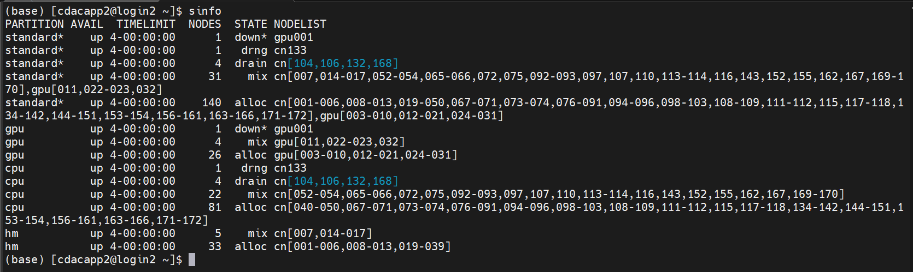
sinfo
-sinfo reports the state of partitions and nodes managed by Slurm. It has a wide variety of filtering, sorting, and formatting options.

Slide 18
Types of Nodes
NOTE: These naming Conventions are used in our NSM system deployed by CDAC ,it may vary system to system
CPU only nodes: (memory per core)
These nodes are designed for general-purpose computing and do not have any GPUs.
They are identified by the node names cn001, cn002, cn003, cn004, and so on, up to cn384
Nodes with high memory: (memory per core)
These nodes are specifically equipped with a higher amount of memory per core, making them suitable for memory-intensive tasks.
They are denoted by the node names hm001, hm002, hm003, and so on, up to hm036.
Nodes with GPUs:
These nodes are equipped with Graphics Processing Units (GPUs), enabling accelerated computing for tasks that can benefit from parallel processing on GPUs.
They are identified by the node names gpu001, gpu002, gpu003, and so on, up to gpu02

Slide 19
SLURM Commands
Jobs in SLURM can be submitted using two modes: batch mode,and interactive mode
Batch Mode: which involves submitting a job using sbatch.
Interactive Mode: which allows job submission using srun or salloc.
sbatch is used to submit a job script for later execution. The script will typically contain one or more srun commands to launch parallel tasks.
sbatch <my_sample_bash_script>
- salloc is used to allocate resources for a job in real time.
salloc --time=1:00:00 --partition=gpu --nodes=1

Slide 20
SLURM Options
Option | Description
-nodes=<number> | Number of nodes to use
-ntasks=<number> | Number of processes to run
-cpus-per-task=<number> | Number of cores per task
-mem=<number> | Total memory (per node)
- mem-per-cpu=<number> | Memory per processor core
-constraint=<attribute> | Node property to request (e.g., xeon-4116)
-partition=<partition name> | Request nodes on specified partition
-time=<D-HH:MM:SS> | Maximum run time
-account=<account id> | Account to charge resources to
- -mail-type=<value> | E-mail notifications (e.g., begin|end|fail|all)
--mail-user=<address> | E-mail address
-output=<filename> | File for standard output
-error=<filename> | File for standard error

Slide 21
Running SLURM : Sample script
#!/bin/bash
#SBATCH --nodes=1
#SBATCH --ntasks-per-node=1
#SBATCH --time=00:05:00
#SBATCH –-partition=cpu
#SBATCH -o %j.out
#SBATCH -e %j.err
srun hostname
srun echo ${SLURM_JOBID}

Slide 22
Running SLURM : Sample script
Send the job to the scheduler with the sbatch command: sbatch sample.sh
You will see text like “Submitted batch job 35298” get written to the terminal
Two files will be generated:
<job_id>.err
<job_id>.out

Slide 23
Running SLURM : Serial job
#!/bin/sh
#SBATCH --nodes=1 # specify number of nodes
#SBATCH --ntasks-per-node=1 # specify number of CPU cores per node
#SBATCH --time=00:10:00 # specify maximum duration of run in
hours:minutes:seconds format
#SBATCH --job-name=hello # specify job name
#SBATCH --error=job.%J.err # specify error file name
#SBATCH --output=job.%J. out # specify output file name
#SBATCH --partition=cpu # specify type of resource such as CPU/GPU/Highmemory etc
cd $SLURM_SUBMIT_DIR # change to directory from where job is submitted
### Set your environment (e.g. load required compiler, application)
module load intel/oneapi/mpi/2021.4.0
### Your command for Serial Execution (i.e. execution on one CPU core)
time ./<executable>

Slide 24
Running SLURM : OpenMP jobs
#!/bin/bash
#SBATCH --job-name=openmp
#SBATCH --ntasks=1
#SBATCH --cpus-per-task=4
#SBATCH --time=10:00
#SBATCH --output=ompresult.txt
export OMP_NUM_THREADS=$SLURM_CPUS_PER_TASK
srun ./hello.omp

Slide 25
Running SLURM : MPI job
#!/bin/bash
#SBATCH --nodes=2 # specify number of nodes
#SBATCH --ntasks-per-node=2 # specify number of cores per node
#SBATCH --time=01:00:00 # specify maximum duration of run in
hours:minutes:seconds format
#SBATCH --job-name=mpi_hello # specify job name
#SBATCH --error=job.%J.err # specify error file name
#SBATCH --output=job.%J.out # specify output file name
#SBATCH --partition=standard # specify type of resource such as CPU/GPU/High memory etc.
### Load the default MPI module
module load intel/oneapi/mpi/2021.4.0
### Run the mpi program with mpirun
mpirun -np $SLURM_NTASKS ./hello.mpi

Slide 26
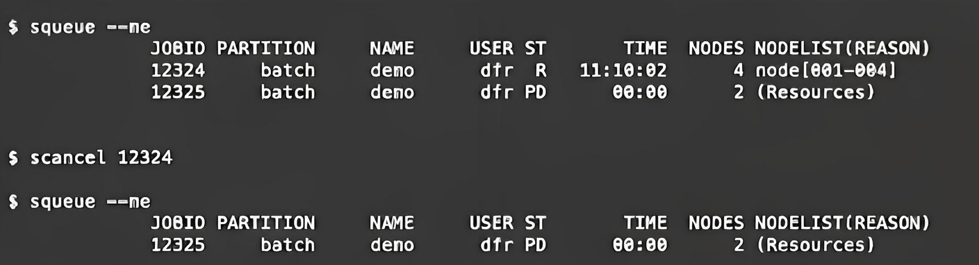
Scancel
- scancel cancel a submitted job
scancel <jobid>
scancel -u <username>
scancel -t PENDING -u <username>
scancel –name <myjobname>

Slide 27
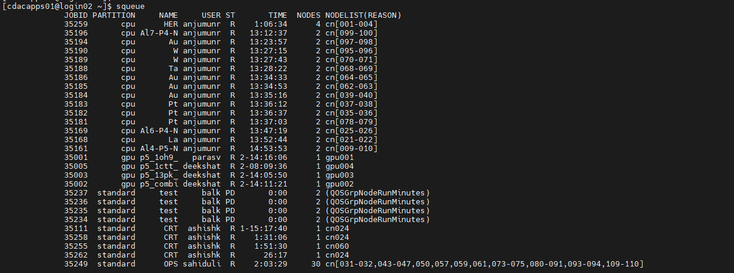
Squeue
-squeue reports the state of jobs or job steps. It has a wide variety of filtering, sorting, and formatting options. By default, it reports the running jobs in priority order and then the pending jobs in priority order.

Slide 28
Scontrol
scontrol command can be used to report more detailed information about nodes, partitions, jobs, job steps, and configuration.
It can also be used by system administrators to make configuration changes
scontrol show partition
scontrol show node <nodename>
scontrol show job <job_id>
scontrol show res
scontrol create res (can be run from root access only)
scontrol create reservation StartTime=2022-09-05T09:45:00 EndTime=2022-09-18 user=team4,gg,fff partition=gpu node=gpu01

Slide 29
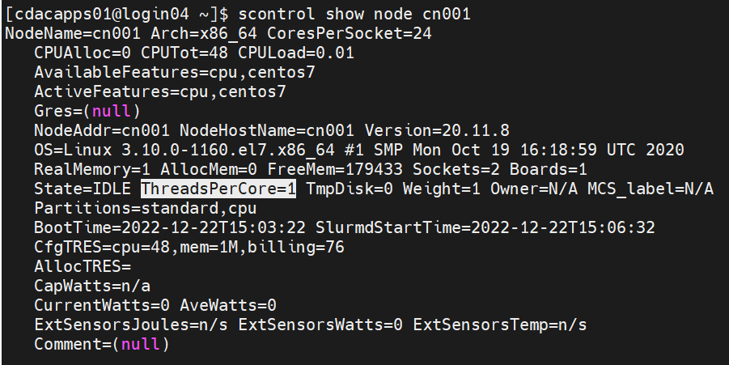
Scontrol

Slide 30
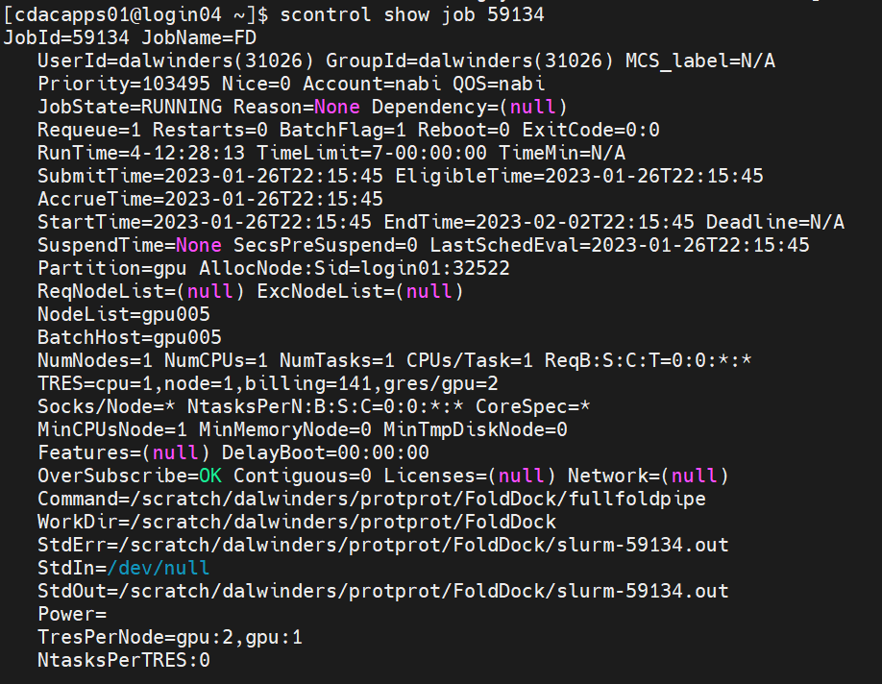
Scontrol

Slide 31
SLURM Job Status
ALLOCATED - The node has been allocated to one or more jobs
IDLE - The node is not allocated to any jobs and is available for use
DOWN - Node is not available for use
MIXED - The node has some of its CPUs ALLOCATED while others are IDLE
RESERVED - The node is in an advanced reservation and not generally available

Slide 32
SLURM Job Status Code
Status | Code | Explanation
COMPLETED | CD | The job has been completed successfully
FAILED | F | The job terminated with a non-zero exit code and failed to execute
PENDING | PD | The job is waiting for resource allocation. It will eventually run
RUNNING | R | The job currently is allocated to a node and and is is running.
SUSPENDED | S | A running job has been stopped with its cores released to other jobs.

Slide 33
SLURM Job Reason Code
Reason Code | Explanation
Priority | One or more higher priority jobs is in queue for running. Your job will eventually run
Dependeney | This job is waiting for a dependent job to complete and will run afterwards
Resources | The job is waiting for resources to become available and will eventually run
InvalidAccount | The job's account is invalid. Cancel the job and rerun with correct account
QOSGrpMaxJobsLimit | Maximum number of jobs for your job's QoS have been met; job will run eventually
ReqNodeNotAvail | Some node specifically required by the job is not currently available; job will run eventually

Slide 34
Conclusion
SLURM is a versatile and efficient workload manager
SLURM Key Points:
flexibility
scalability
rich Feature
SLURM provides the tools and capabilities to optimize job execution, improve resource utilization, and enhance overall productivity in the HPC domain.

